Slide 1



Comparing LSTM & CNN Models for Fake Job Information Detection
Team members
Ingyin Khine (G2203677C)
Mao Zunjie (G2203665L) Zhang Yitian (G2203654E)

Slide 2

INTRODUCTION
DATASET PRE-PROCESSING
CONTENT
CNN & LSTM models
COMPARISON & ANALYSIS
CONCLUSION

Slide 3

PART I
INTRODUCTION

Slide 4
PART 1 INTRODUCTION
Background
Text mining is the process of analyzing and extracting useful information and insights from unstructured text data
01
Project is targeted to explore text classification. The motivation comes from the problem of job scams and fraudulent job postings. By building a model, we can accurately detect fake job postings.
02
The project involves collecting and preprocessing data, selecting appropriate features, training, tuning machine learning models, and evaluating their performance.
03

Slide 5
PART 1 INTRODUCTION
Objectives in our project
1
2
3
Improve the efficiency & effectiveness of the job screening process for companies or job seekers by automatically flagging potentially fraudulent job postings
Provide insights & recommendations to relevant authorities or organizations preventing job scams and protecting job seekers
Develop an effective machine learning model that accurately detects fraudulent job postings

Slide 6
PART II
DATASET PREPROCESSING

Slide 7

PART II. DATASET PRE-PROCESSING
Data source
Downloaded from kaggle.com which is a popular website for data science and machine learning enthusiasts
参考文献
Dataset has 17880 job posts with 18 columns
17014 real jobs and 866 fake jobs in this dataset
Figure 1. https://www.kaggle.com/datasets/shivamb/real-or-fake-fake-jobposting-prediction/code?datasetId=533871&sortBy=voteCount

Slide 8
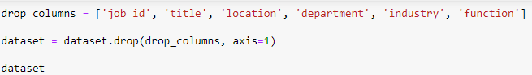
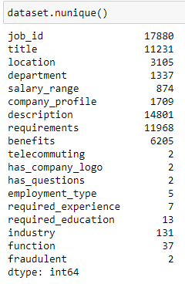
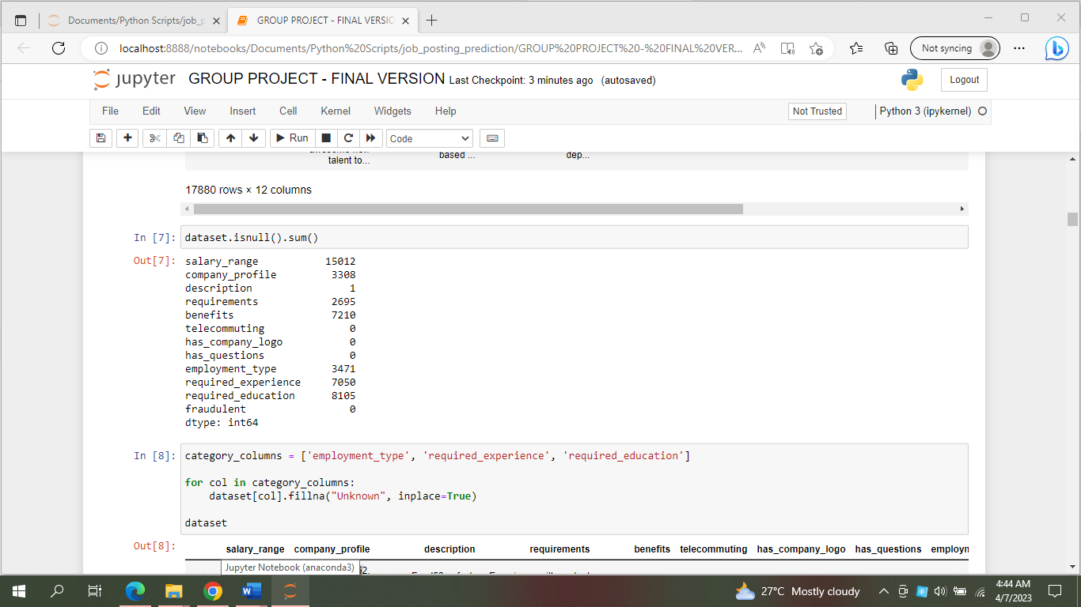
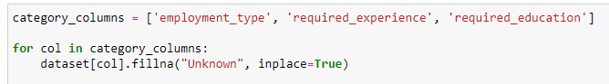
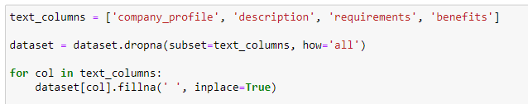
PART II. DATASET PRE-PROCESSING
Data cleaning
参考文献
Figure 2.
Figure 3.

Slide 9
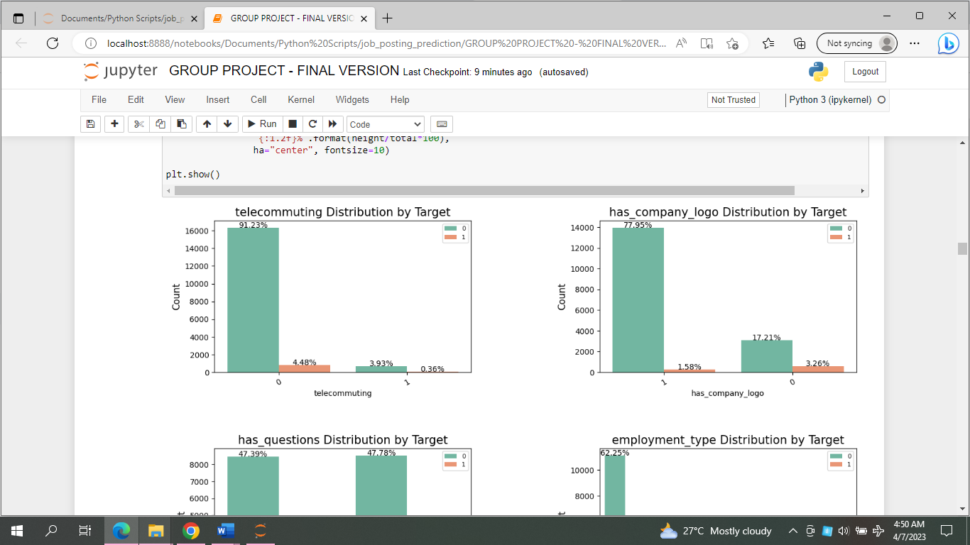
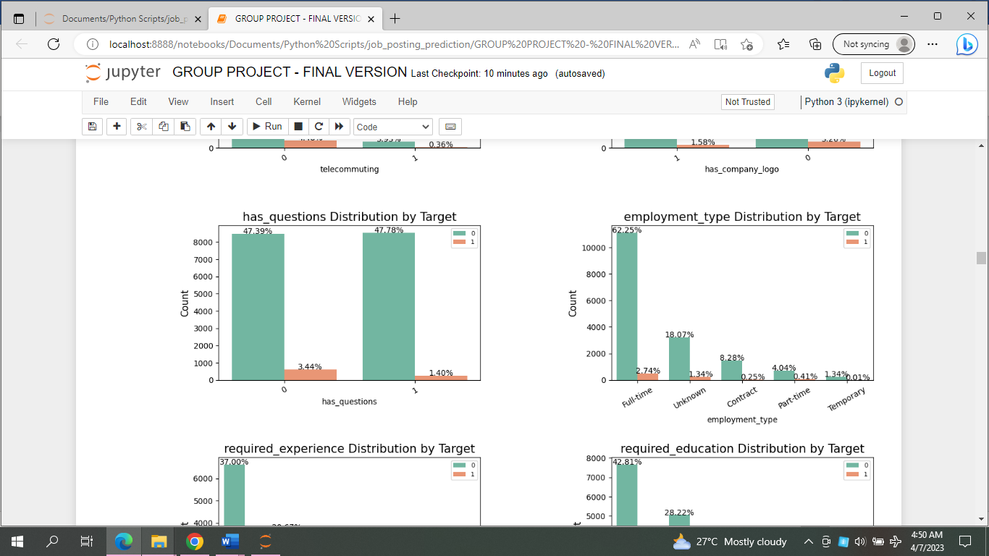
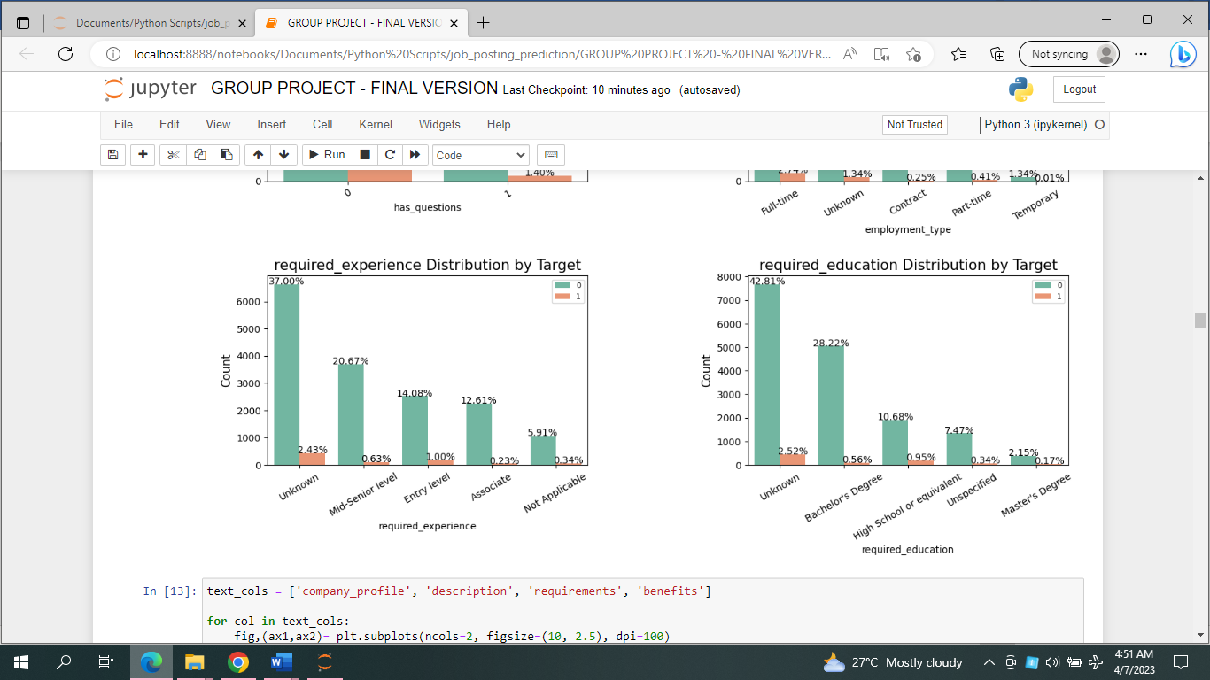
PART II. DATASET PRE-PROCESSING
Exploratory Data Analysis
Figure 4.

Slide 10
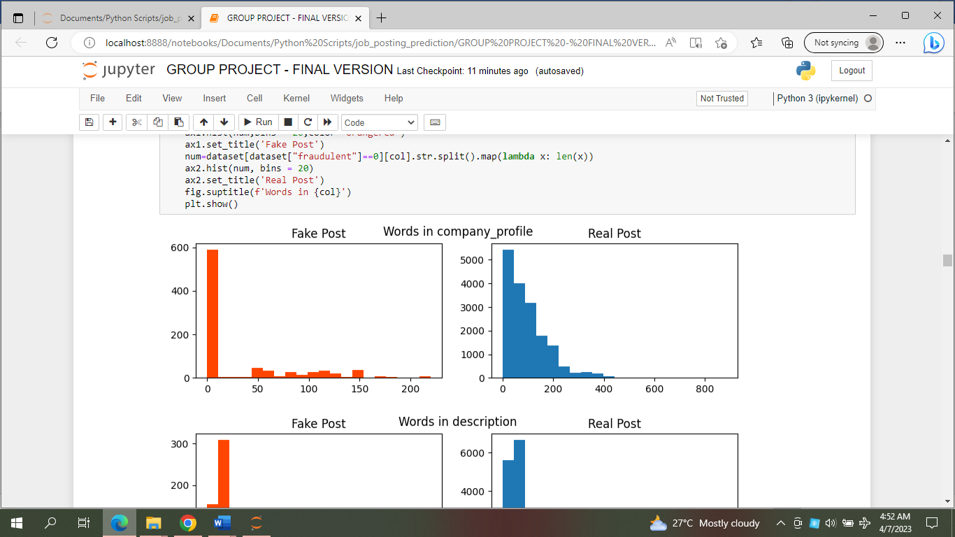
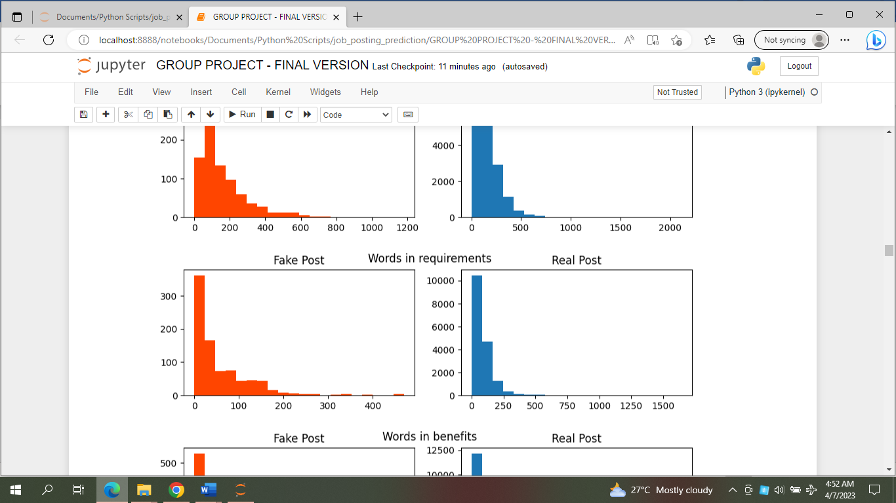
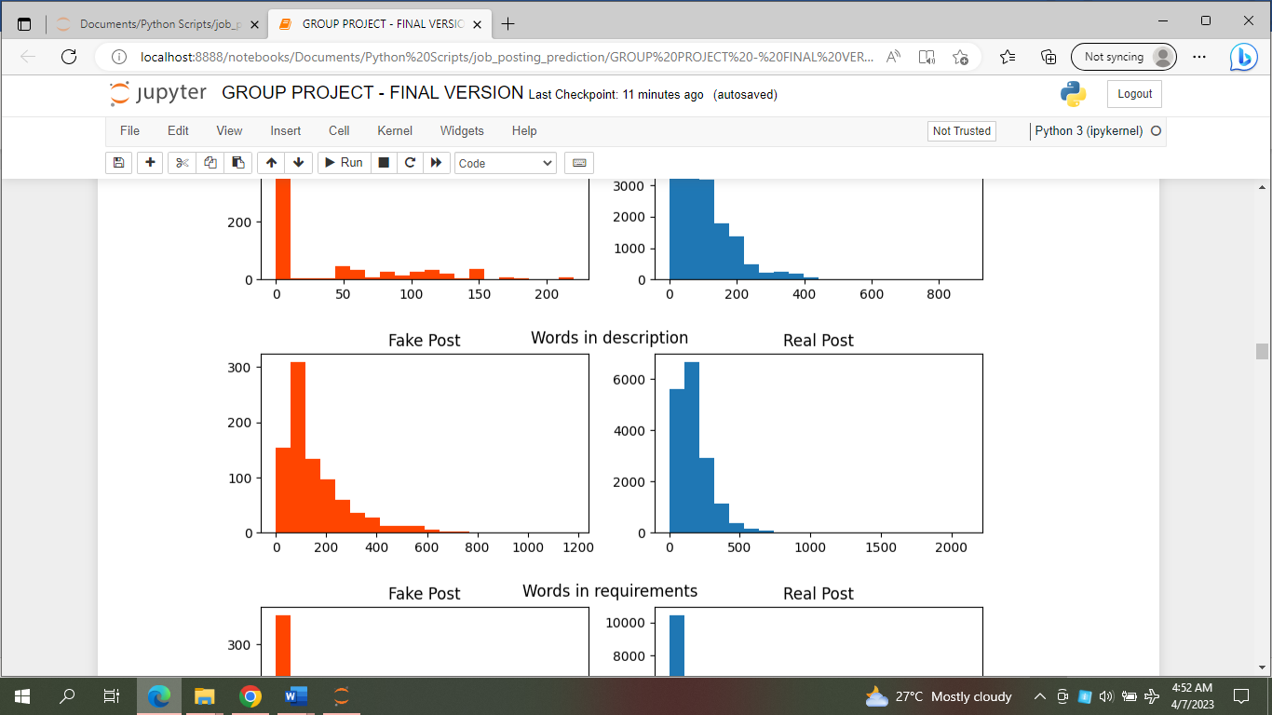
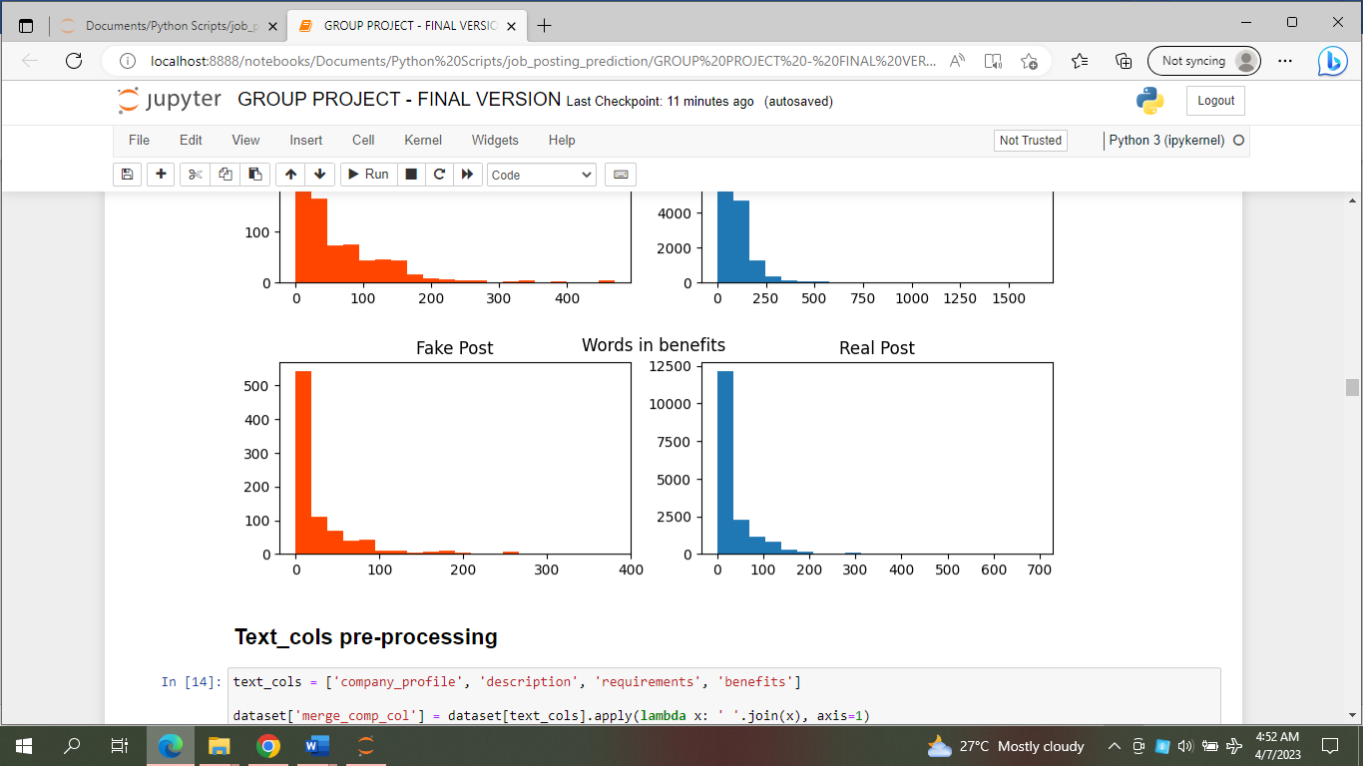
PART II. DATASET PRE-PROCESSING
Exploratory Data Analysis
Figure 5.
Figure 6.

Slide 11
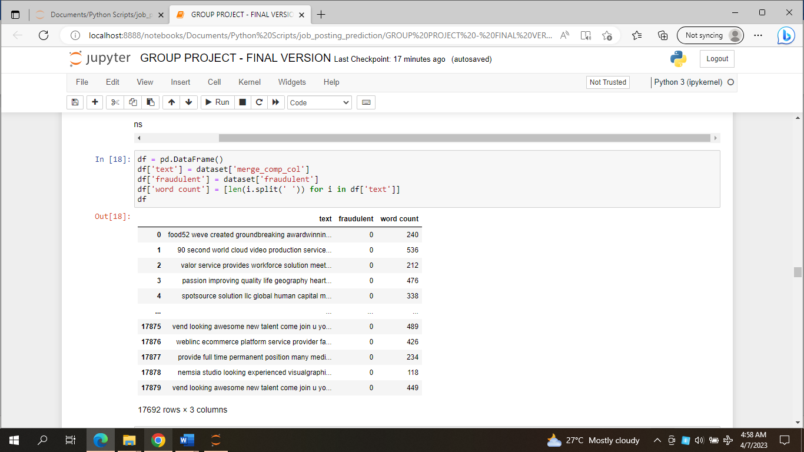
PART II. DATASET PRE-PROCESSING
Text pre-processing
consolidation
Consolidate all contents of ‘company_profile’, ‘description’, ‘requirements’, and ‘benefits’ features into one feature
tokenization
Split the text into smaller units (words)
Stopwords: Remove common words that do not provide much meaning, such as "the," "a," and "an.”
Non-English words: Remove words that contain non-English words.
certain words removal
Create processed dataset
Create a new processed dataset for future classification.
Figure 7. Processed dataset

Slide 12
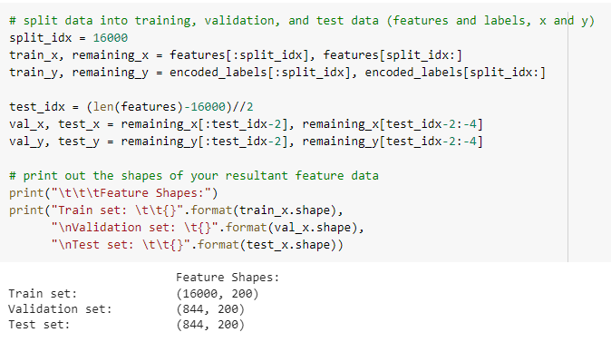
PART II. DATASET PRE-PROCESSING
Data Splitting
16000 elements (90.44%) for training
参考文献
844 elements (4.77%) for validation
844 elements (4.77%) for testing
Figure 8. Splitting dataset

Slide 13
PART IV. Comparison & Analysis
Data Splitting for each Dataset
Posts | Training | Validation | Testing
Real | 11879 | 2635 | 2313
Fake | 505 | 17 | 339

Slide 14
PART III
CNN & LSTM Model

Slide 15
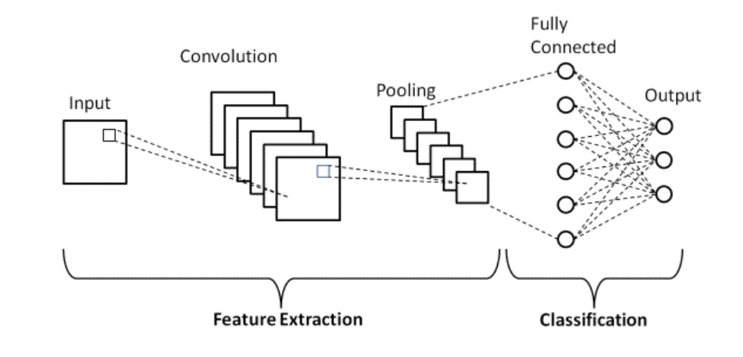
PART III. CNN & LSTM models – CNN model
Architecture of CNN model
The architecture of this CNN model is implemented using PyTorch. The main components of the model include an embedding layer, a convolutional layer, a pooling layer, a dropout layer, and fully connected layer and sigmoid layers. ​

Slide 16


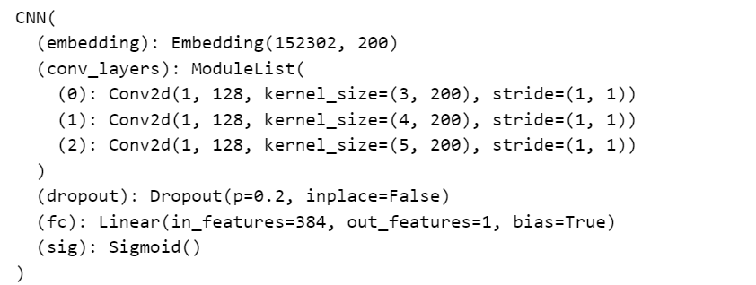
PART III. CNN & LSTM models – CNN model
CNN Model Training & Testing
In the model construction phase, we focus on the hyperparameter setting of the model for CNN. We define the loss function as BCELoss, the optimizer as Adam, and the learning rate is set to 0.001. We set embedding_dim as 200, totally have 20 epochs, and use ReduceLROnPlateau as the scheduler to reduce the learning rate by a factor of 0.1 if there is no decrease in the validation loss.
Final Testing Result is:
In the testing phase, the performance of the trained model was assessed on a separate test dataset that was not utilized during either training or validation stages. The model's ability to generalize on unseen data was evaluated through metrics such as accuracy and loss.

Slide 17
PART III. CNN & LSTM models – LSTM model
Architecture of LSTM model
“positive”
First, we'll pass in words to an embedding layer.
We need an embedding layer because we have tens of thousands of words, so we want to provide a more efficient and effective representation of the input sequence by encoding each word as a dense vector in a lower-dimensional embedding space instead of one-hot representation.
Second, the new embeddings will be passed to LSTM cells.
The LSTM cells will add recurrent connections to the network and give us the ability to include information about the sequence of words in the article data.
Finally, the LSTM outputs will go to a sigmoid output layer.
We're using a sigmoid function because positive (or fake info) = 1 and negative (or real info) = 0, and a sigmoid will output predicted, sentiment values between 0-1.
Sigmoid
Sigmoid
Sigmoid
LSTM
LSTM
LSTM
Embed
Embed
Embed
best
movie
ever

Slide 18
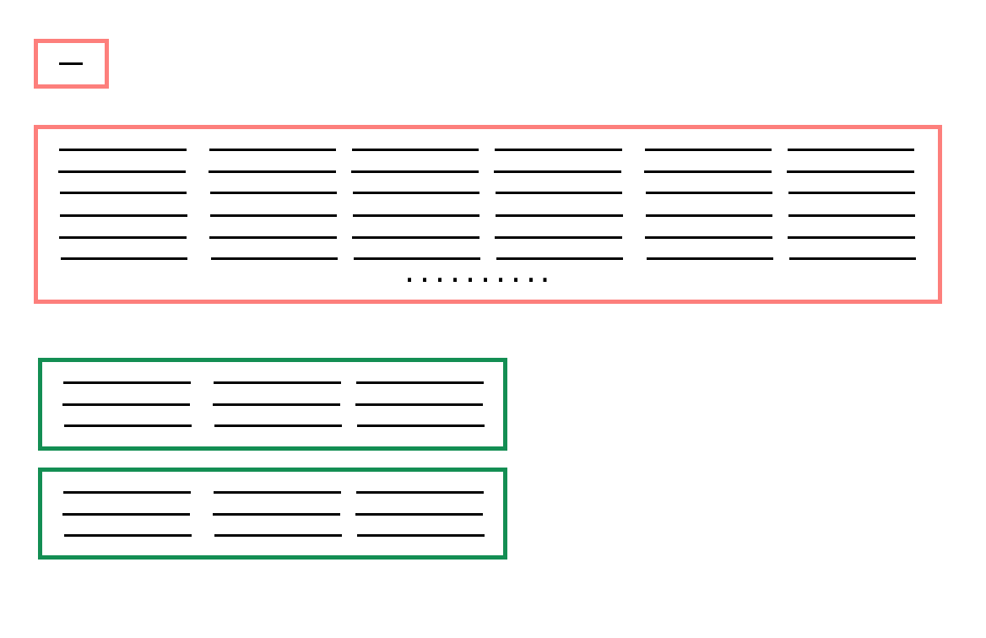
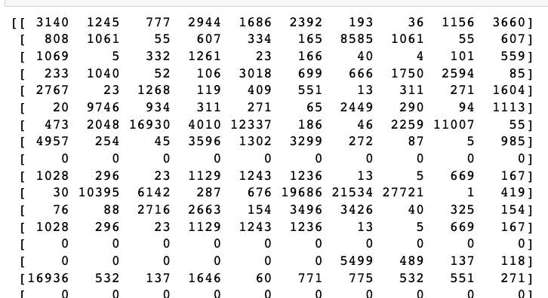
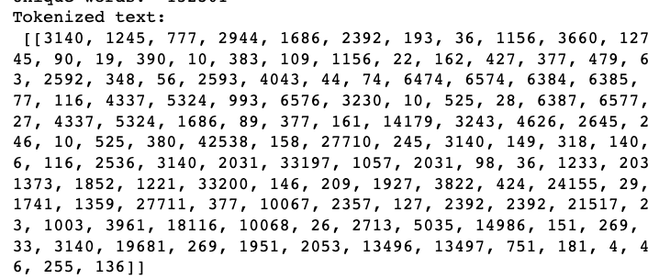
PART III. CNN & LSTM models – LSTM model
Text preparation for LSTM model
1. Encoding the words
The embedding lookup requires that we pass in integers to our network. So we create dictionaries that map the words in the vocabulary to integers. Then we can convert each of our texts into a list of integers so they can be passed into the network.
2. Padding sequences
To deal with both short and long articles, we'll pad or truncate all our articles to a specific length. For texts shorter than that, we'll pad with 0s. For texts longer than that, we can truncate. A good sequence length, in this case, is 200.

Slide 19

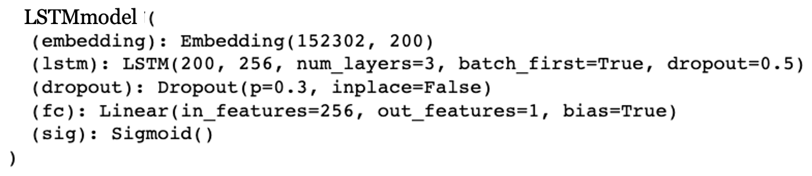
PART III. CNN & LSTM models — LSTM model
LSTM Model Training & Testing
The model was trained using binary cross-entropy loss and the Adam optimizer with a learning rate of 0.001. The training process was run for 20 epochs, with gradient clipping at 5 to prevent gradients from exploding. During training, both the training loss and validation loss were calculated. If the validation loss decreased, the model was saved. After each epoch, the accuracy was calculated and displayed.
Final Testing Result is:
During the testing phase, the trained model was evaluated on the test dataset, which was not used during training or validation. The model's performance was evaluated using accuracy and loss, to determine how well it performed on the unseen data.

Slide 20
PART IV
Comparison & Analysis

Slide 21

PART IV. Comparison & Analysis
Best Hyperparameters in CNN & LSTM
MODEL | Embedding dim | Learning rate | dropout | Scheduler factor
CNN | 200 | 0.001 | 0.2 | 0.1
LSTM | 200 | 0.001 | 0.3 | 0.1

Slide 22
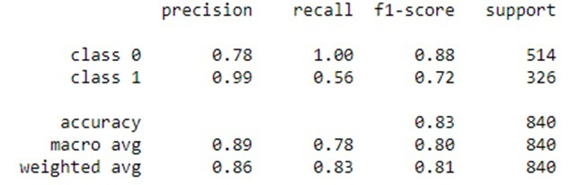
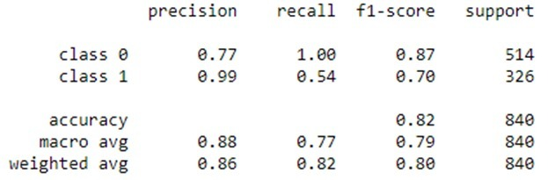
PART IV. Comparison & Analysis
Summary of results in CNN & LSTM
Classification report in CNN
MODEL | PRECISION | RECALL | F1 SCORE | TEST ACCURACY
CNN | 0.86 | 0.83 | 0.81 | 82.35%
LSTM | 0.86 | 0.83 | 0.80 | 81.64%
Overall, both models have similar performance in detecting fake job information, with CNN slightly outperforming LSTM in terms of F1 score, and test accuracy. …
Classification report in LSTM
However, the results is a little bit different from our expectations…
Based on the conventional wisdom of deep learning, LSTM is better at NLP while CNN is better at processing images. But our results is a bit off from our expected.

Slide 23
PART IV. Comparison & Analysis
Speculation on the possible causes
Possible reason 1: CNNs are better at capturing local features.
Possible reason 2: LSTMs may be more susceptible to overfitting.
Possible reason 3: More effective hyperparameter tuning in CNN.
CNNs excel at capturing local features in text, enabling them to detect patterns in short segments of text. This makes them well-suited for identifying misleading words and phrases in fake news headlines and articles.
Overfitting occurs when a model is too complex and learns to fit the noise in the training data instead of the underlying patterns. Since the LSTM model has significantly more parameters than the CNN model, it may be more prone to overfitting on this dataset.
Effective hyperparameter tuning can impact the performance of model. It's possible that the CNN model performed better because the hyperparameters were tuned more effectively for the task of detecting fake job information compared to the LSTM model .

Slide 24
PART IV. Comparison & Analysis
Analyze “High precision & Low recall”
Classification report in CNN
From the classification report, both models have high precision and low recall on class 1, suggests that the model is conservative in its predictions.
In other word, it is more likely to make a correct prediction when it predicts that a job posting is fake, but it may miss some actual fake job postings.
Classification report in LSTM
One possible reason is that the model may be biased towards the majority class (i.e., real job postings) during the training process, which can lead to an overemphasis on avoiding false positives and sacrificing true positives.

Slide 25
PART V
Conclusion

Slide 26
PART V. Conclusion
Summary of our project
Limitations & Reflections
However, there are some limitations in our project.
Not balancing the data: No. of fake job postings is significantly smaller than the number of real job postings, the model may learn to prioritize accuracy on the majority class, resulting in high precision but low recall for the minority class.
Overfitting during the training process, this problem contributed to lower accuracy in test set than training set.
Limited evaluation metrics: While the project reports several evaluation metrics, such as precision, recall, F1 score, and test accuracy, there are other metrics that could be used to evaluate the models' performance.
To sum up, our study utilized both CNN and RNN models to predict fake job postings.
Overall, both models performed well, but it was a little bit difference from we expected.
It's possible that the CNN model in this case has learned to identify certain patterns or features in the text data that are indicative of fake job information, while the LSTM model has focused more on the sequence of words in the text.
This highlights the importance of experimenting with different model architectures and hyperparameters for each specific task to find the optimal model.

Slide 27
Thank you for listening

